Slide 1

From Reform to Reality: Navigating
the next wave of design law disputes
EUIPO Alicante, IPCLC 2026, May 21, 2026
Dr. Philipe Kutschke
Attorney-at-Law, Partner, Certified IP Lawyer, Commercial Mediator (MuCDR)

Slide 2

From Reform to Reality:
Navigating the next wave of design law disputes
  Transit
  Repair Clause
  Digital Designs
  3D Printing & AI

Slide 3


Transit, New Article 19 (3) EUDR
The holder of a registered EU design shall be entitled to prevent all third parties from bringing products, in the course of trade, from third countries into the Union, that are not released for free circulation in the Union, where the design is identically incorporated in or applied to those products, or the design cannot be distinguished in its essential aspects from such products, and the right holder’s authorisation has not been given.

Slide 4

Transit, New Article 19 (3) EUDR
Level playing field with Art. 9(4) EUTMR: Full alignment of border enforcement for EU designs and EU trademarks regarding goods in transit
Burden of Proof: The declarant must prove that the products are legal in the final destination country to stop a seizure
Impact: Overrules the restrictive legacy of the "Nokia/Philips" transit case law for designs.
Think Global: Underlines high relevance of national design rights outside EU
Notes:
Hintergrund: Vor der Markenrechtsreform 2015 (die in der UMV 2017 kodifiziert wurde) galt die restriktive Rechtsprechung des EuGH (Nokia/Philips, Urteil vom 01.12.2011, verbundene Rechtssachen C-446/09 und C-495/09). Damals durften Transitwaren nur beschlagnahmt werden, wenn nachgewiesen wurde, dass sie für den Verkauf in der EU bestimmt waren ("commercial diversion"). Mit Art. 9 Abs. 4 UMV wurde dies zugunsten der Rechteinhaber korrigiert – eine Änderung, die das Designrecht nun endlich nachvollzieht.

Slide 5
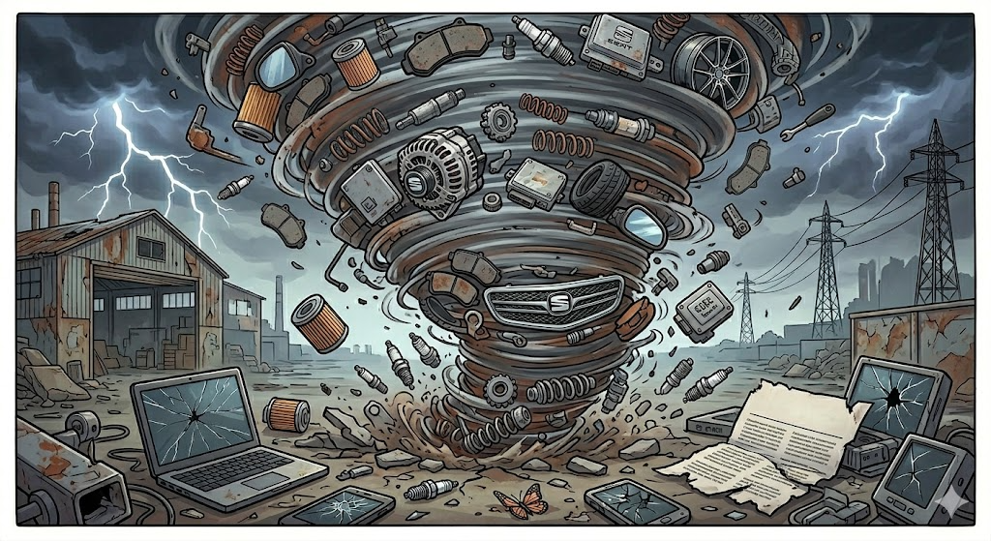
Repair clause – NEW Article 20A EUDR
1. Protection shall not be conferred on an EU design which constitutes a component part of a complex product upon whose appearance the design of the component part is dependent, and which is used within the meaning of Article 19(1) for the sole purpose of the repair of that complex product so as to restore its original appearance.
2. Paragraph 1 shall not be invoked by the manufacturer or the seller of a component part of a complex product who failed to duly inform consumers, through a clear and visible indication on the product or in another appropriate form, about the commercial origin, and the identity of the manufacturer, of the product to be used for the purpose of the repair of the complex product, so that they can make an informed choice between competing products that can be used for the repair.
3. The manufacturer or seller of a component part of a complex product shall not be required to guarantee that the component parts they make or sell are ultimately used by end users for the sole purpose of repair so as to restore the original appearance of the complex product.’;
Notes:
Reducing somewhat economic impact that acacia could have had on the long run

Slide 6
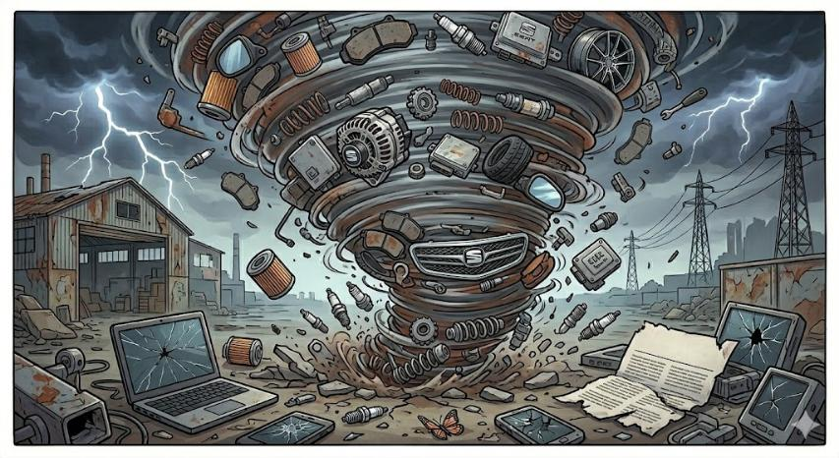
Repair clause – NEW Article 20A EUDR
Scope of designs
  “component part of a complex product“
  "restore original appearance"
  (strictly form-dependent parts, identical)
  “upon whose appearance the design of the component part is dependent”
Transparency Requirement
  obligation to inform consumers applies to manufacturer and any seller
  content: commercial origin, identity of the manufacturer, purpose of repair only
  clear and visible indication (language, transparency)
  "in appropriate form": product, packaging, catalogues
Notes:
„Acacia soft“ (EuGH, Urteil vom 20.12.2017 – Acacia vs Audi/PorscheC-397/16, C-435/16 )?
1. The Definition: form-dependency (“must-match”)
Under the new Article 20a EUDR, the repair clause only applies if the component part is form-dependent. This means its shape is compulsorily dictated by the appearance of the complex product.
Radiator Grilles (Kühlergrille): YES, these are generally covered. A grille must fit into the specific structural opening of the car's front. If you change the design, it no longer "restores the original appearance."
Body Panels (Kotflügel/Motorhauben): YES, these are the classic examples.
Headlights (Scheinwerfer): YES, as they must follow the lines of the bodywork.
2. The Controversial Case: Rims (Felgen)
This is where the reform has likely changed the status quo for your audience:
Under the old law (Art. 110 / Acacia Doctrine): The CJEU previously allowed a broad interpretation. In the Acacia case (C-397/16), it was argued that rims could be covered if the consumer needed an identical rim to match the remaining three on the car (also for radiator grills, body panels).
Under the NEW law (post-May 2025): The consensus among experts and recent rulings (including the German BGH in late 2025 regarding key housings) is that Rims are likely EXCLUDED from the repair clause.
Why? Rims are considered "freely designed" parts. While you want them to match for aesthetic reasons, the car’s overall appearance is not structurally dependent on that specific rim design. You could put four different rims on a car, and it would still be a "repaired" car. Unlike a hood, a rim does not have to have one specific shape to complete the "skin" of the vehicle.
Covered (Must-Match): Hoods, fenders, bumpers, grilles, lamps, windshields.
NOT Covered (Freely Designed): Rims, floor mats, seat covers, key housings, hubcaps.
The Shift: The reform "clawed back" protection for car manufacturers on parts where a consumer has a choice, even if that choice is aesthetically motivated.

Slide 7
Repair clause – NEW Article 20A EUDR
No liability of manufacturer/sellers
Exception applies to
  repair only (no tuning)
  EU-designs only (no defense against accused trademark infringement)
Transition period
  EU Level: no, Art. 20a EUDR
  in force since 01/05/2025
  National Level: transition period
  until 08/12/2032
Notes:
Grandfathering rule for national designs: Article 19 (4) Directive (EU) 2024/2823
Until December 8, 2032 (18 November 2024 + 20 days + 8 years)

Slide 8
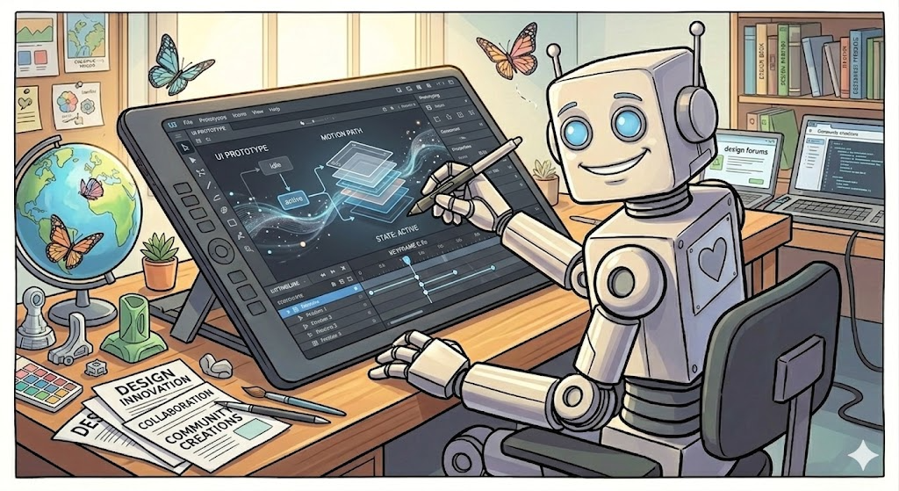
Digital Design – anything new?
Expanded Definitions: The definition of "Product" now explicitly includes Graphic User Interfaces (GUIs), virtual objects, and spatial arrangements (interior/exterior environments)
Dynamic Designs: The legal definition of "Design" includes movement, transition, or any other sort of animation e.g., the way a menu slides or an icon transforms
Representations (as of 01/07/2026)
  no limitation to 7 static views, now including animations or movement sequences (important for UI/UX designs)
  video files (MP4) and 3D files (OBJ or STL) to be accepted
Notes:
Subsequent applications trap!

Slide 9
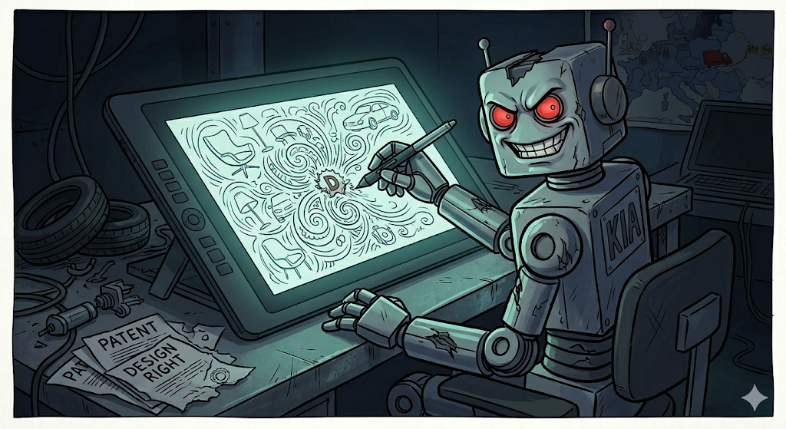
Digital designs – anything new?
AI generated designs as prior art
Notes:
The Problem: AI may flood the internet with prior art
The present standard:
Article 7 EUDR: Disclosure:
A design shall be deemed to have been made available to the public if it has been published following registration or otherwise, or exhibited, used in trade or otherwise disclosed, before the date referred to in Articles 5(1)(a) and 6(1)(a) or in Articles 5(1)(b) and 6(1)(b), as the case may be, except where these events could not reasonably have become known in the normal course of business to the circles specialised in the sector concerned, operating within the Community.
How to resolve?
Apply present standard?
Exclude as such?
Complete new approach, only if corresponding real products exist?
“could reasonably become aware of”? (see Deity Shoes, Gautzsch, Crocs T-651/16, Puma Rihana)
does 12months grace period help?

Slide 10
3D Printing & AI – Article 19 (1) (d) EUDR
(2) The following, in particular, may be prohibited under paragraph 1
(d) creating, downloading, copying and sharing or distributing to others any medium or software which records the design for the purpose of enabling a product referred to in point (a) to be made

Slide 11

3D Printing & AI – Article 19 (2) (d) EUDR
Art. 19(2)(d) EUDR: The new weapon against digital design piracy
Broad Scope: Targets “any medium or software" (including digital results), not just the physical object
Strategic Impact: Allows enforcement at the “source" (the digital generation phase) rather than the "Store" (the physical sale phase).
AI Assistants & AI created designs
  "any medium or software“
  "records“?
  "for the purpose of“?

Slide 12


Dr. Philipe Kutschke
kutschke@bardehle.de
Muito obrigado!

